Slide 1







KitchenSync
Team Neon Nomads

Slide 2

Agenda
01
02
03
04
Introduction
Project Description
Teamworking Agreement
Team Members Roles and Responsibilities
05
06
MVP
Personas
07
User Stories
08
Test Cases
09
10
Product Backlog
Acceptance Criteria
11
Schedule
12
Diagrams

Slide 3
Agenda
13
14
15
16
Algorithms
Technologies and Languages
Retrospective
Burndown Chart
17
WebApp Screenshots
18
Github Link
19
Improvements from last feedback

Slide 4





Introduction
01
KitchenSync is a comprehensive platform designed to make meal planning and pantry management a simple part of your daily routine. It's not just another tool for organizing the kitchen. Whether you're a working professional with a hectic schedule or a parent balancing the obligations of family life, KitchenSync is here to make your kitchen experience more efficient.

Slide 5
Project Description
02
KitchenSync streamlines your pantry management and meal planning seamlessly.
For those with active lifestyles and families
who find it challenging to keep up with their pantry inventory and curb food disposal,
the KitchenSync
is a sophisticated kitchen assistance platform,
that enhances the management of your pantry and offers recipe options that fit your available ingredients, organizes meal plans, and reminds you of the shelf life of your food items,
unlike conventional inventory systems and static shopping list apps
our application intelligently adapts to your dietary preferences and schedule, guaranteeing the optimal use of your groceries and simplifying the meal preparation process.

Slide 6





Team Members & Roles
03
Hemanvitha
Mylapalli
Shashank Akavaram
Neha Srinivasaiah
Frontend Developer
Team Leader
Frontend Developer
Scrum Master
Yuga Kapil Krishna
Maytheramatla
Devops Engineer
Backend Developer

Slide 7

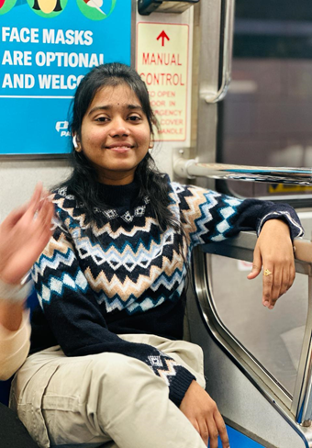


Team Members & Roles
Bala Sahithi
Kamana
Sasank
Nannapaneni
Aditya Gadhave
Sujitha Chethireddy
Software Developer
Backend Developer
Software Developer
Software Test Engineer

Slide 8


Teamwork Aggrement
04
The goal of our Teamwork Agreement is to establish expectations for behavior in an attempt to foster collaboration and productivity.
The specific roles and responsibilities of each member may vary as the project progresses.
One meeting per week is scheduled for Saturdays, and daily meetings are held for Scrum. Important decisions will be made collectively, documented, and shared with all participants.
Agendas are distributed beforehand by WhatsApp or email.
Document link :Team work aggrement.doc

Slide 9



Personas
05
A persona is an imaginary client that personifies the traits of a subset of your customers. For the purpose of creating your product or service, the Persona provides useful information about those clients' demographics. Their objectives, driving forces, and constraints.

Slide 10



Persona 1
Cael 21 years old, freshman
Background: A freshman at Pace University from a low-income family living in a dormitory. He’s on a tight budget and needs to make his grocery shopping as efficient as possible.
Personality: Cheerful, disciplined, hardworking, initiative
Needs: Cael wants a system that can help him manage his dormitory mini fridge and pantry inventory, suggest recipes based on available ingredients, and remind him to replenish items before they expire.

Slide 11



Persona 2
Ella 32 years old, Advocate
Background: Ella is an advocate who is leading a busy lifestyle. She is health conscious and enjoys cooking nutritious meals at home.
Personality: Altruistic, organized, passionate, perseverance
Needs: Ella is mindful of food waste and wants a system that efficiently handles her food inventory. She seeks a system that recommends recipes according to her dietary preference and nutritional goals while also alerting her of the upcoming expiry dates of her inventory.

Slide 12



Persona 3
Michelle 44 years old, Advocate
Background: Michelle is a working mom of four. She juggles between a demanding job and household responsibilities.
Personality: Empathetic, forgiving, nurturing, patience
Needs: Michelle frequently struggles with meal planning and often finds herself throwing food away. She desires a system that assists her in monitoring her food inventory and suggests simple and healthy recipes based on available ingredients and notify her of upcoming expiration dates.

Slide 13
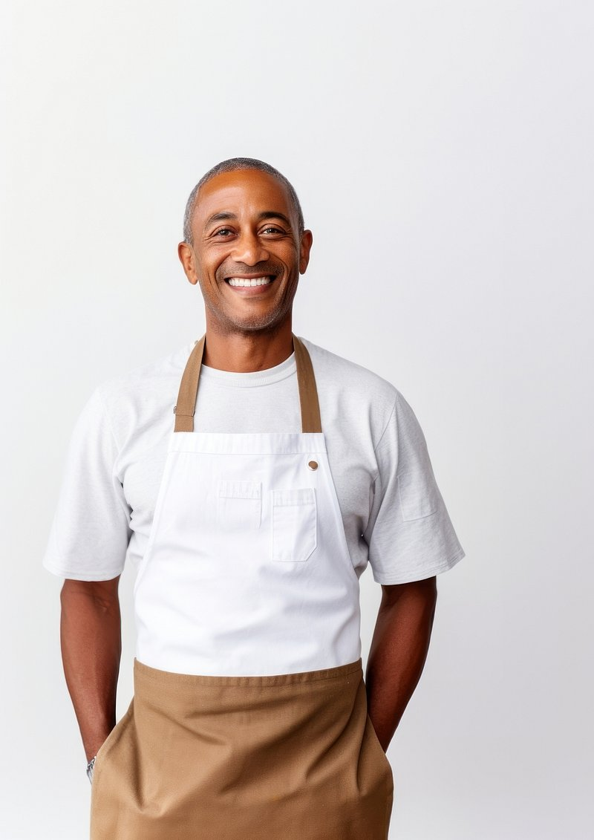


Persona 4
Diego 49 years old, Restaurant Manager
Background: Diego manages a small restaurant specializing in local cuisine. He’s constantly balancing various tasks and often overlooks inventory management, leading to occasional food wastage.
Personality: Creative, Community-Minded, Entrepreneurial, Passionate
Needs: Diego desires a system that can assist him in monitoring the restaurant’s food inventory, suggest recipes utilizing existing ingredients, and alert him about nearing expiry of food items.

Slide 14
MVP(Minimal Viable Product)
06
The MVP of KitchenSync aims to streamline pantry management for busy individuals and families, organizing ingredients, and sending food expiry reminders. It aims to reduce food waste and make cooking easier by adapting to users' dietary needs and schedules.
Benefits: KitchenSync aims to reduce food waste and costs, increase meal prep efficiency, improve nutritional goal adherence, and decrease expired food consumption through smart pantry tracking, tailored recipes, meal planning, and freshness reminders.

Slide 15




User Stories
07
As a student I want to limit the amount I spend on food so that I manage my expenses and also eat healthy
As a mom I want to have knowledge about my pantry so that don’t spend money unnecessarily
As a International student I want to be able to cook for myself so that I could be self sufficient
As a chef I want to utilize my pantry products to the fullest so that I don't waste food
As a user, I want to register and login to the web app so that I can manage my pantry online.

Slide 16



Document link :Userstories.pdf
As a user, I want to add items to my pantry inventory along with their expiry dates so that I can keep track of what I have and when it expires.
As a bakery owner, I want to receive recipe recommendations that help me utilize perishable ingredients efficiently.
As a parent with a hectic schedule, I want to be able to organize my family's meal plans for the week ahead, including lunch for school and dinners for the whole family, so that I can ensure everyone is eating healthy and nutritious meals without the stress of last-minute planning.
As a health-conscious athlete, I want to prioritize tracking expiry dates in my pantry so that I fuel my performance with fresh, nutrient-rich foods, optimizing my diet for peak physical
condition and
recovery.
As a restaurant owner, I want to set alerts for expiring products so that I can prioritize their use in kitchen operations and minimize food waste.

Slide 17
Test Cases
08
Test Case 1: User Account Creation and Login
Test the sign-up process with valid and invalid data.
Test the login process with valid and invalid credentials.
Test password recovery process.
Test Case 2: Pantry Management
Test adding items to the pantry.
Test updating and deleting items in the pantry.
Test searching and sorting the pantry items.
Test Case 3: Expiration Dates tracking
Test alert generation for items that are approaching expiry dates.
Test the time frames for when the alerts should be sent.
Test Case 4: Recipe Recommendations:
Test generating recipe recommendations based on current pantry items.
Test filtering recipes based on dietary restrictions or preferences.
Test the system’s response when there are insufficient items for any recipe recommendation.

Slide 18
Acceptance Criteria
09
Acceptance Criteria for Test Case 1:
The user can create an account using email and setting a password.
The user can log in using his email and password.
The user can recover or reset their password using their verified email.
Acceptance Criteria for Test Case 2:
The user can add their pantry with the required information.
The user can edit or delete items from their pantry.
The user can view their pantry as a sorted list by name or expiry date.
Acceptance Criteria for Test Case 3:
The user receives alerts for the pantry items in the set time frames.
The user can customize alerts timeframes.
Acceptance Criteria for Test Case 4:
The application suggests recipes based on the items available in the pantry.
The system allows the user to filter recipes by dietary restrictions.
If pantry items are insufficient for recommendations, the system informs the user accordingly.

Slide 19
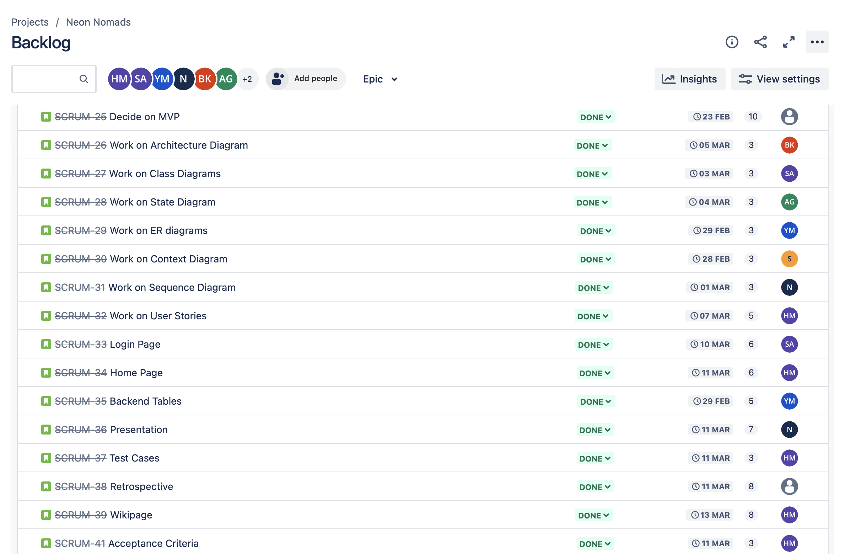
Product Backlog
10
Sprint 2 (feb 15-mar 13)

Slide 20
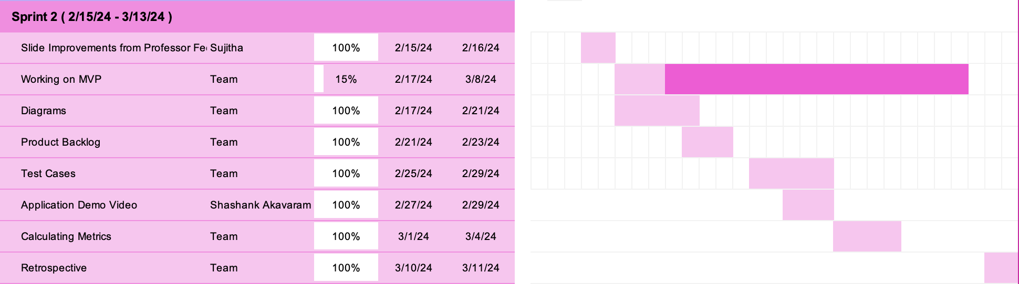
Schedule
11
Sprint 2 (Feb 15- March 13)

Slide 21
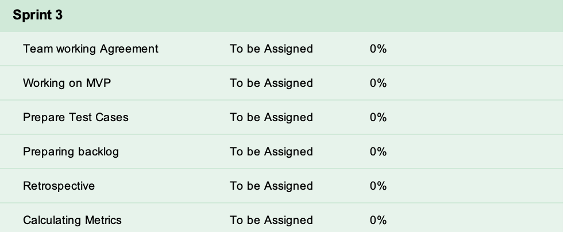
Schedule
11
Next Sprint 3 (March 15- April 10)

Slide 22
Diagrams
12
Architecture Diagram
Context Diagram
ER Diagram
Sequence Diagram
State Diagram
Class Diagram

Slide 23
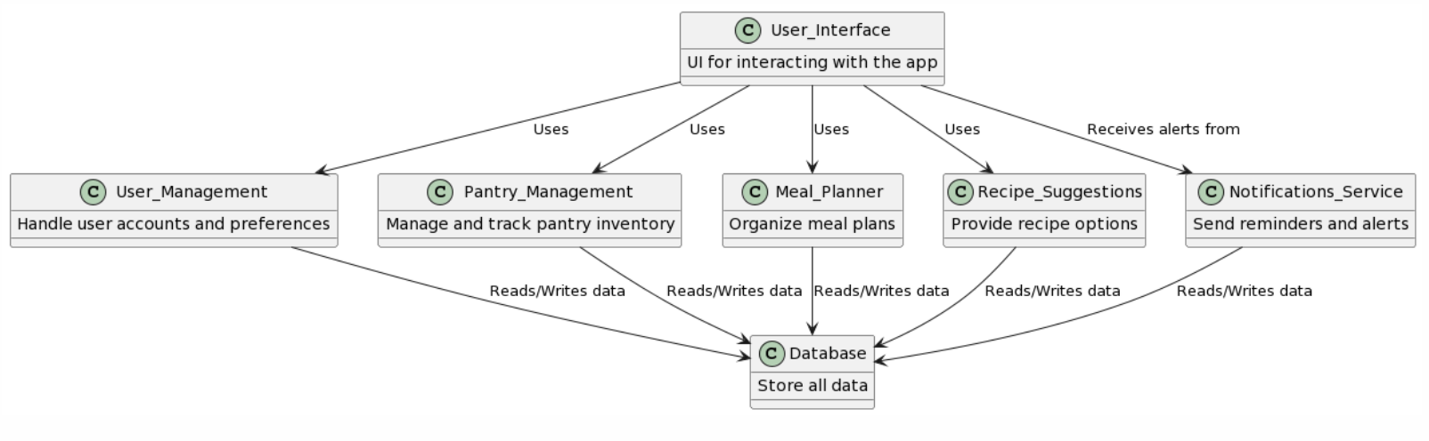
Architecture Diagram

Slide 24
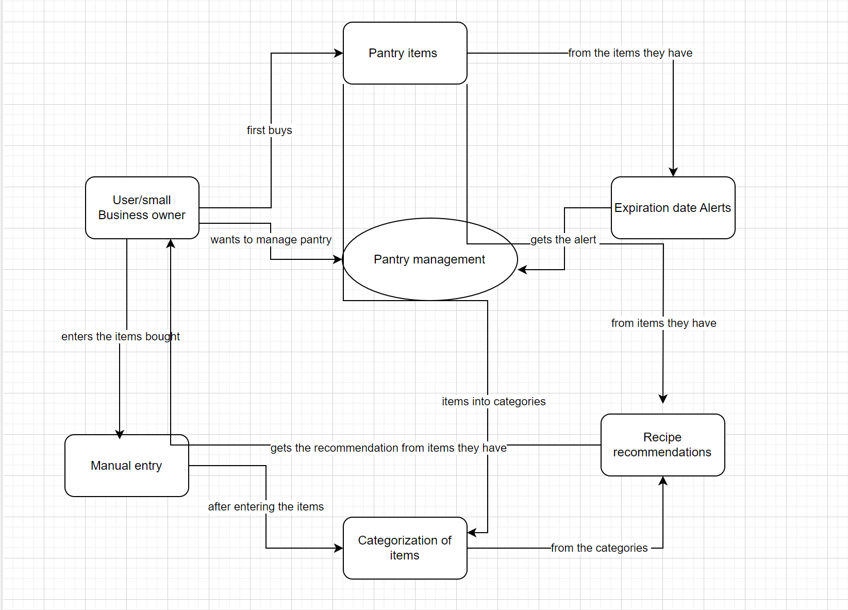
Context Diagram

Slide 25
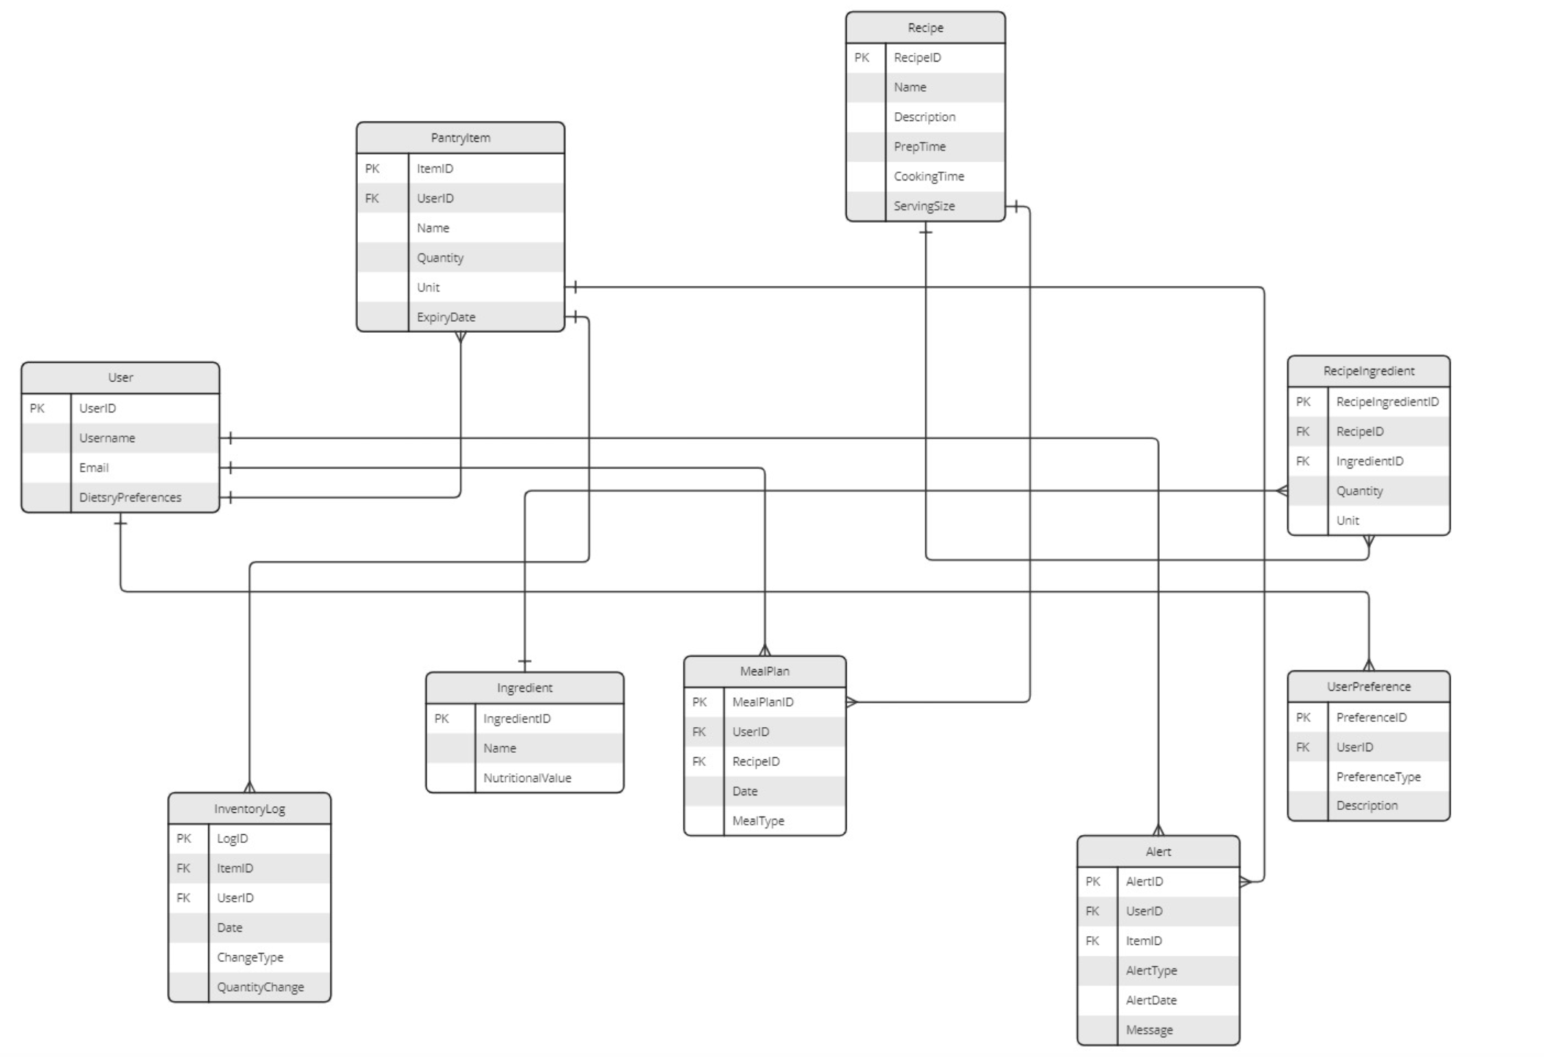
ER Diagram

Slide 26
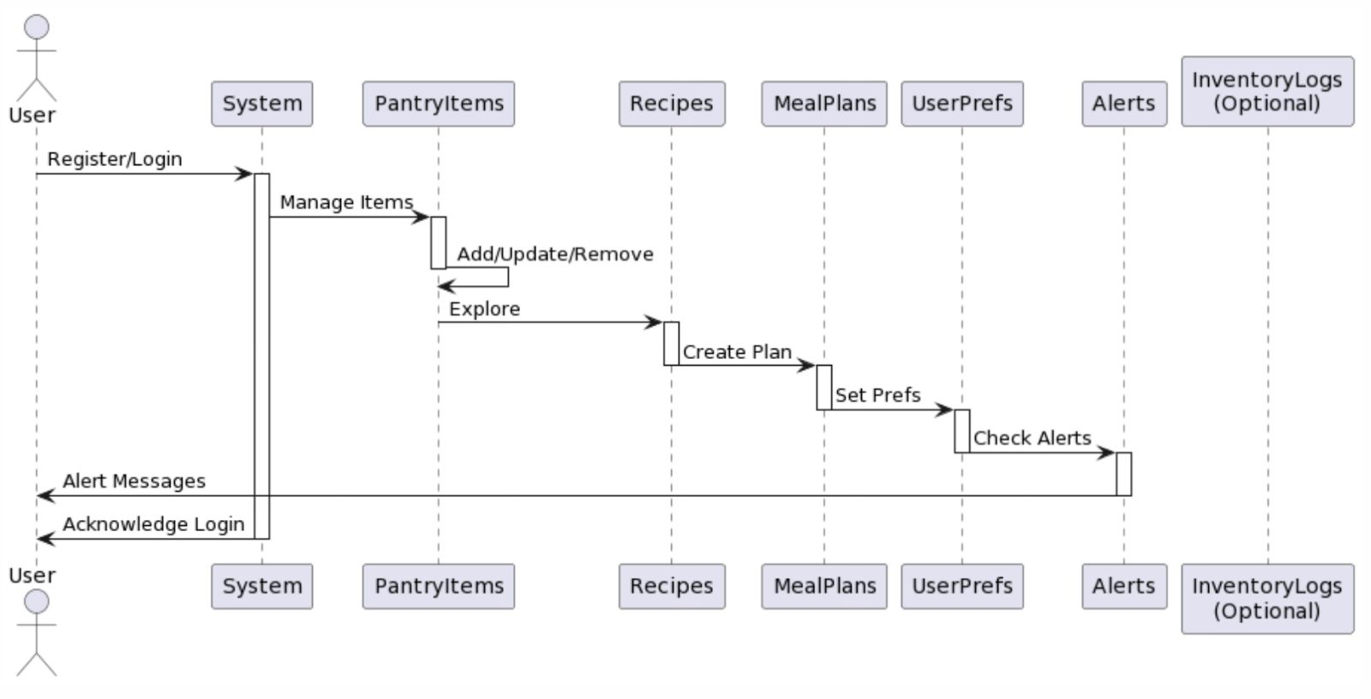
Sequence Diagram

Slide 27
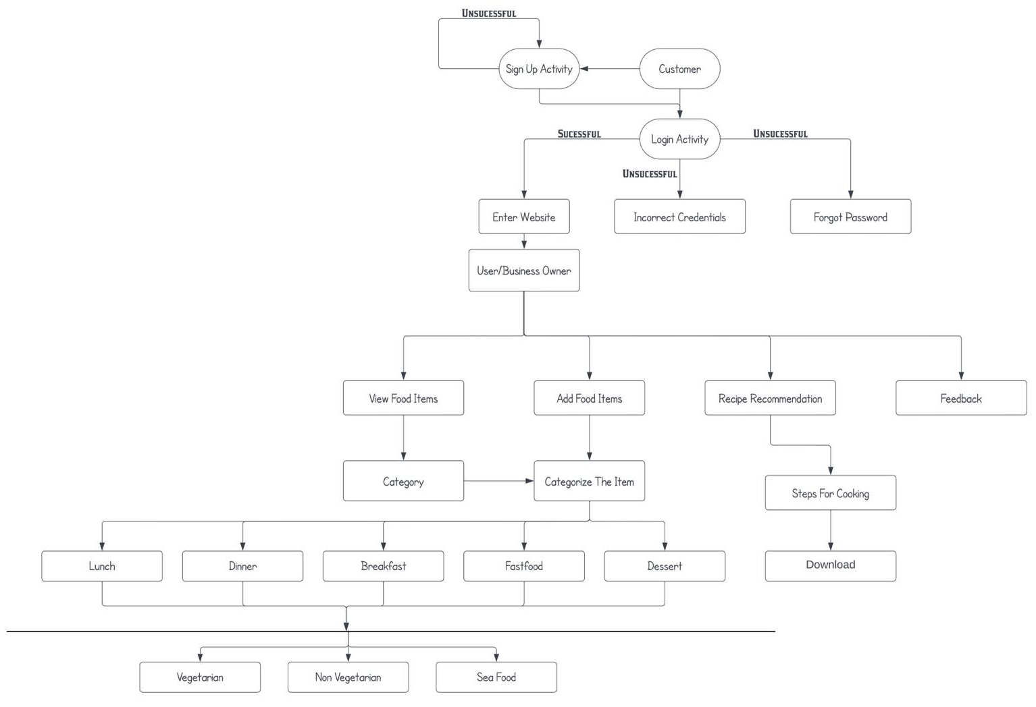
State Diagram

Slide 28
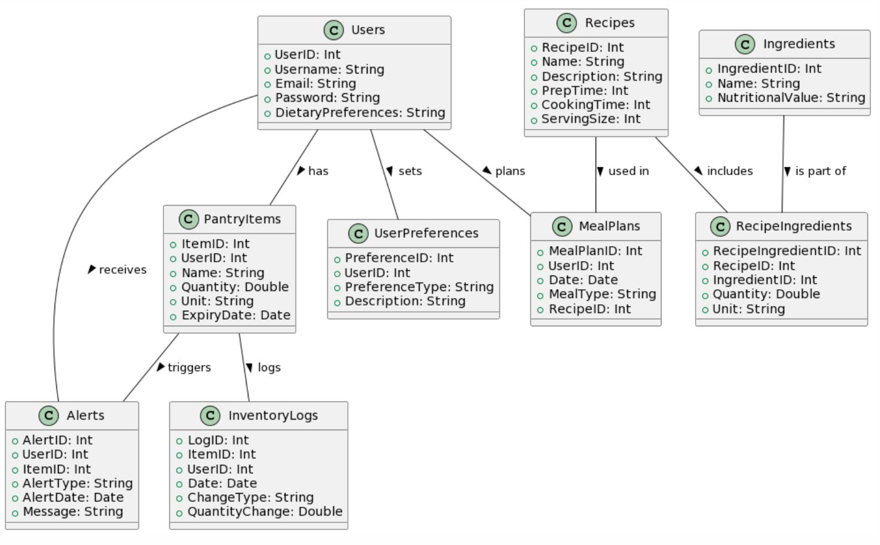
Class Diagram

Slide 29











Technologies and Languages
13
Java
HTML
React
JavaScript
NodeJS
MYsql
VisualStudio Code
GitHub
Jira Board
Figma

Slide 30




Algorithms and Libraries
14
Scikit Learn
PyTorch
SpringBoot
django
K-Nearest Neighbours
Logistic Regression
Decision trees
Long Short Term Memory Networks

Slide 31
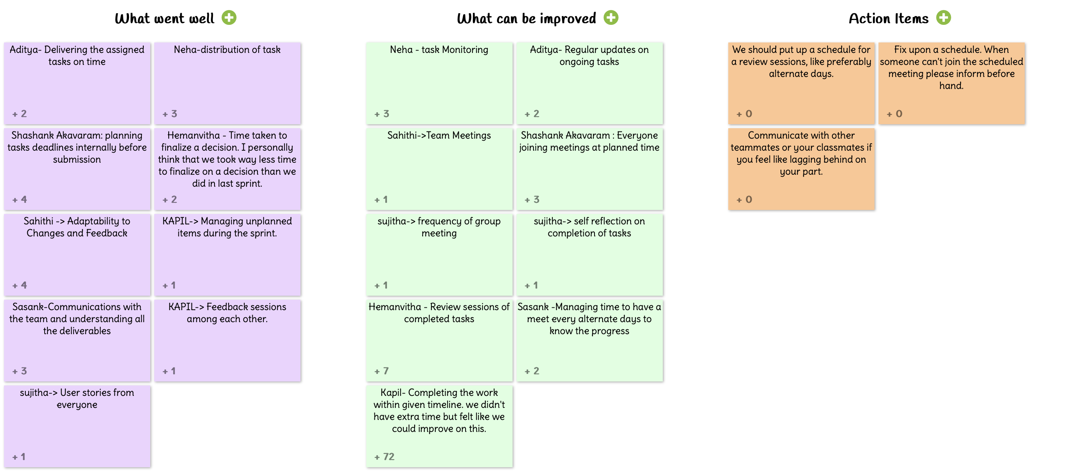
Retrospective
15

Slide 32
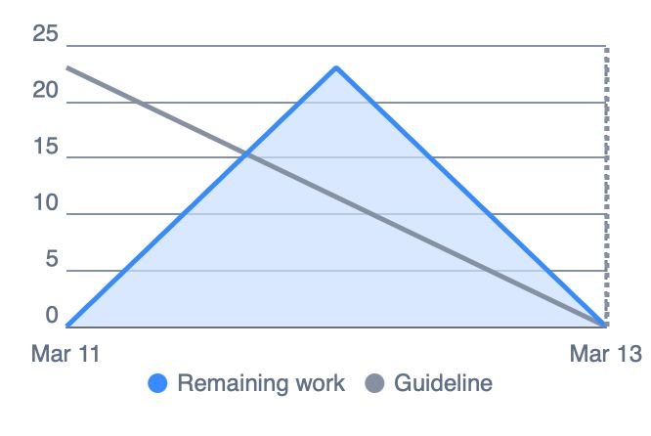
BurnDown Chart
16

Slide 33
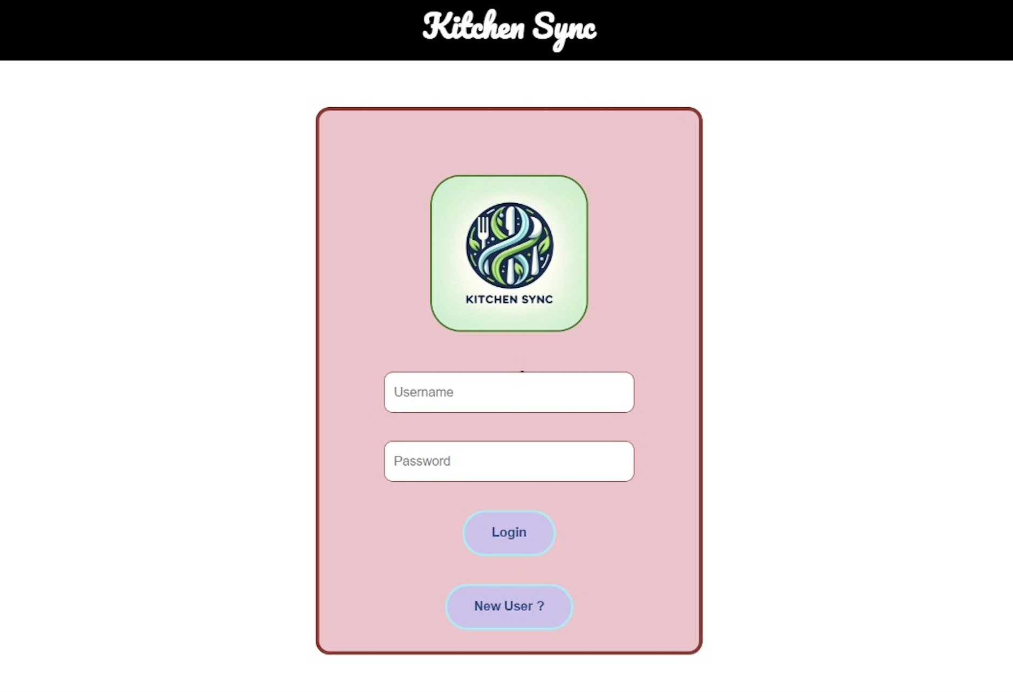
Webapp Screenshots
17

Slide 34
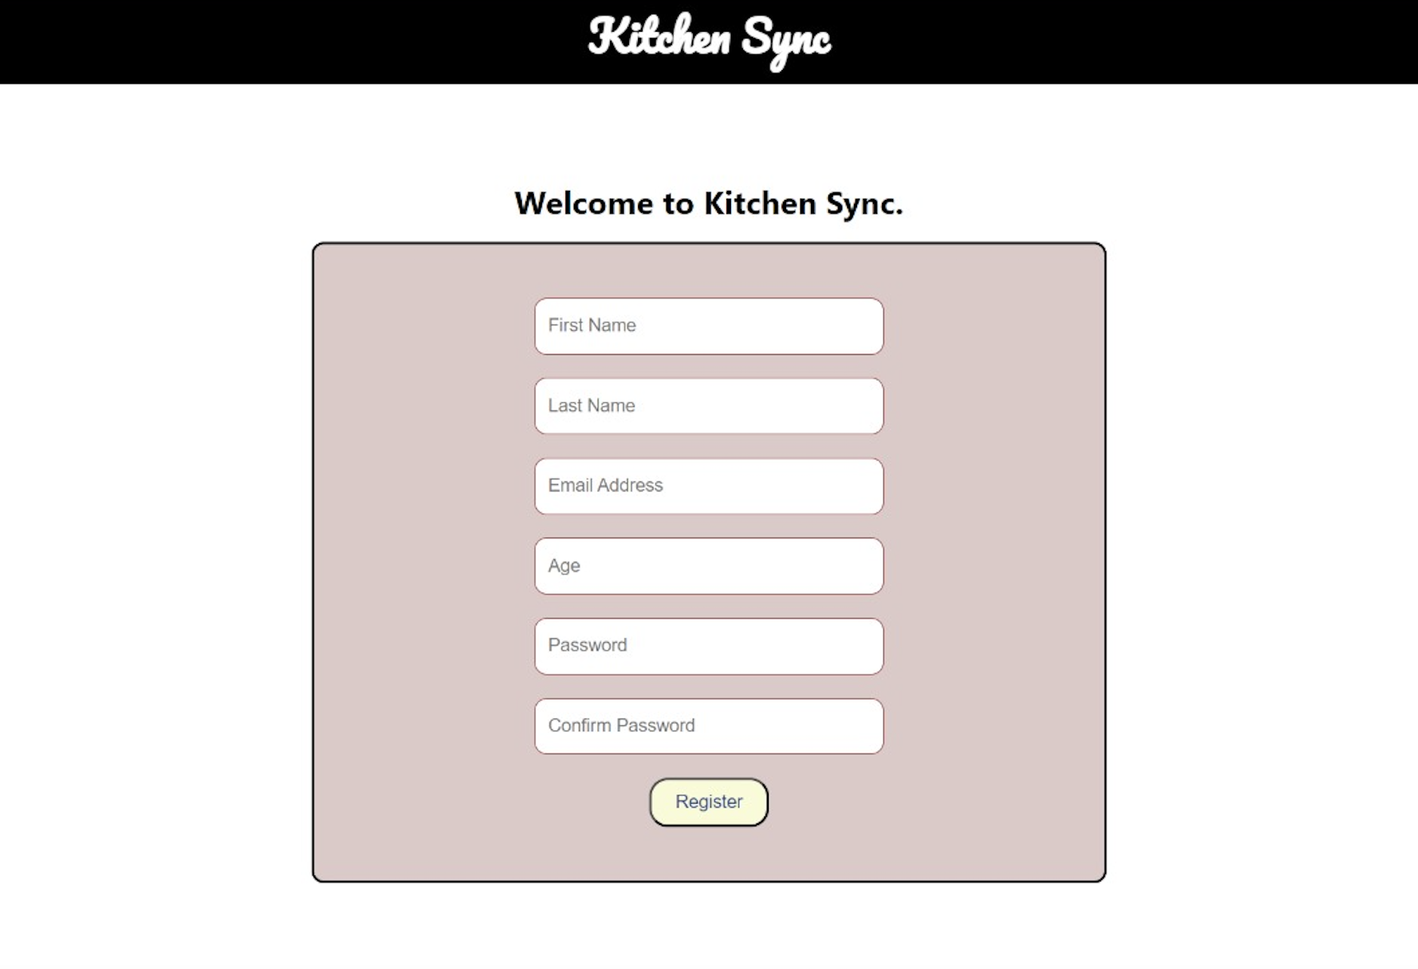
Webapp Screenshots

Slide 35
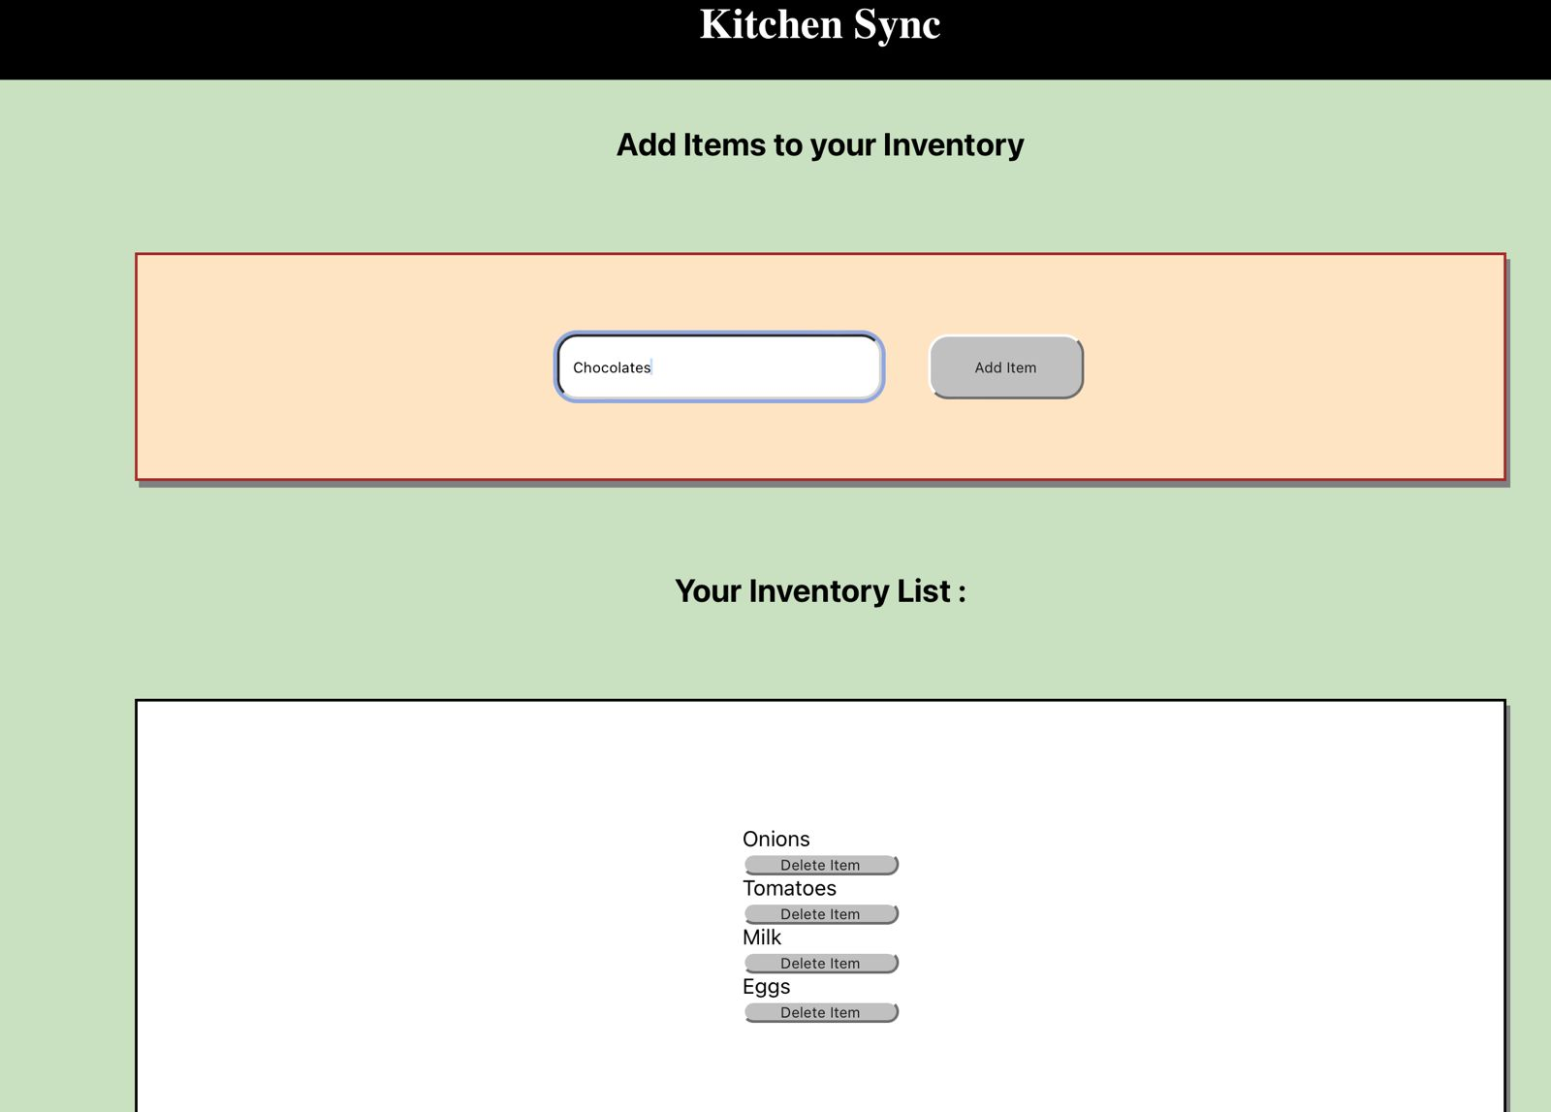
Webapp Screenshots

Slide 36


GITHUB:https://github.com/htmw/2024S-neon-nomads
18

Slide 37
Improvements from Last Feed Back
19
Entire PPT Theme was changed.
Added Opening and Thank You Slide
Removed UID’s from team members slide.
Project Description was added according to provided template
Added Retrospective
Teamwork Agreement Link was added
Algorithms were added
Personas slides were changed

Slide 38

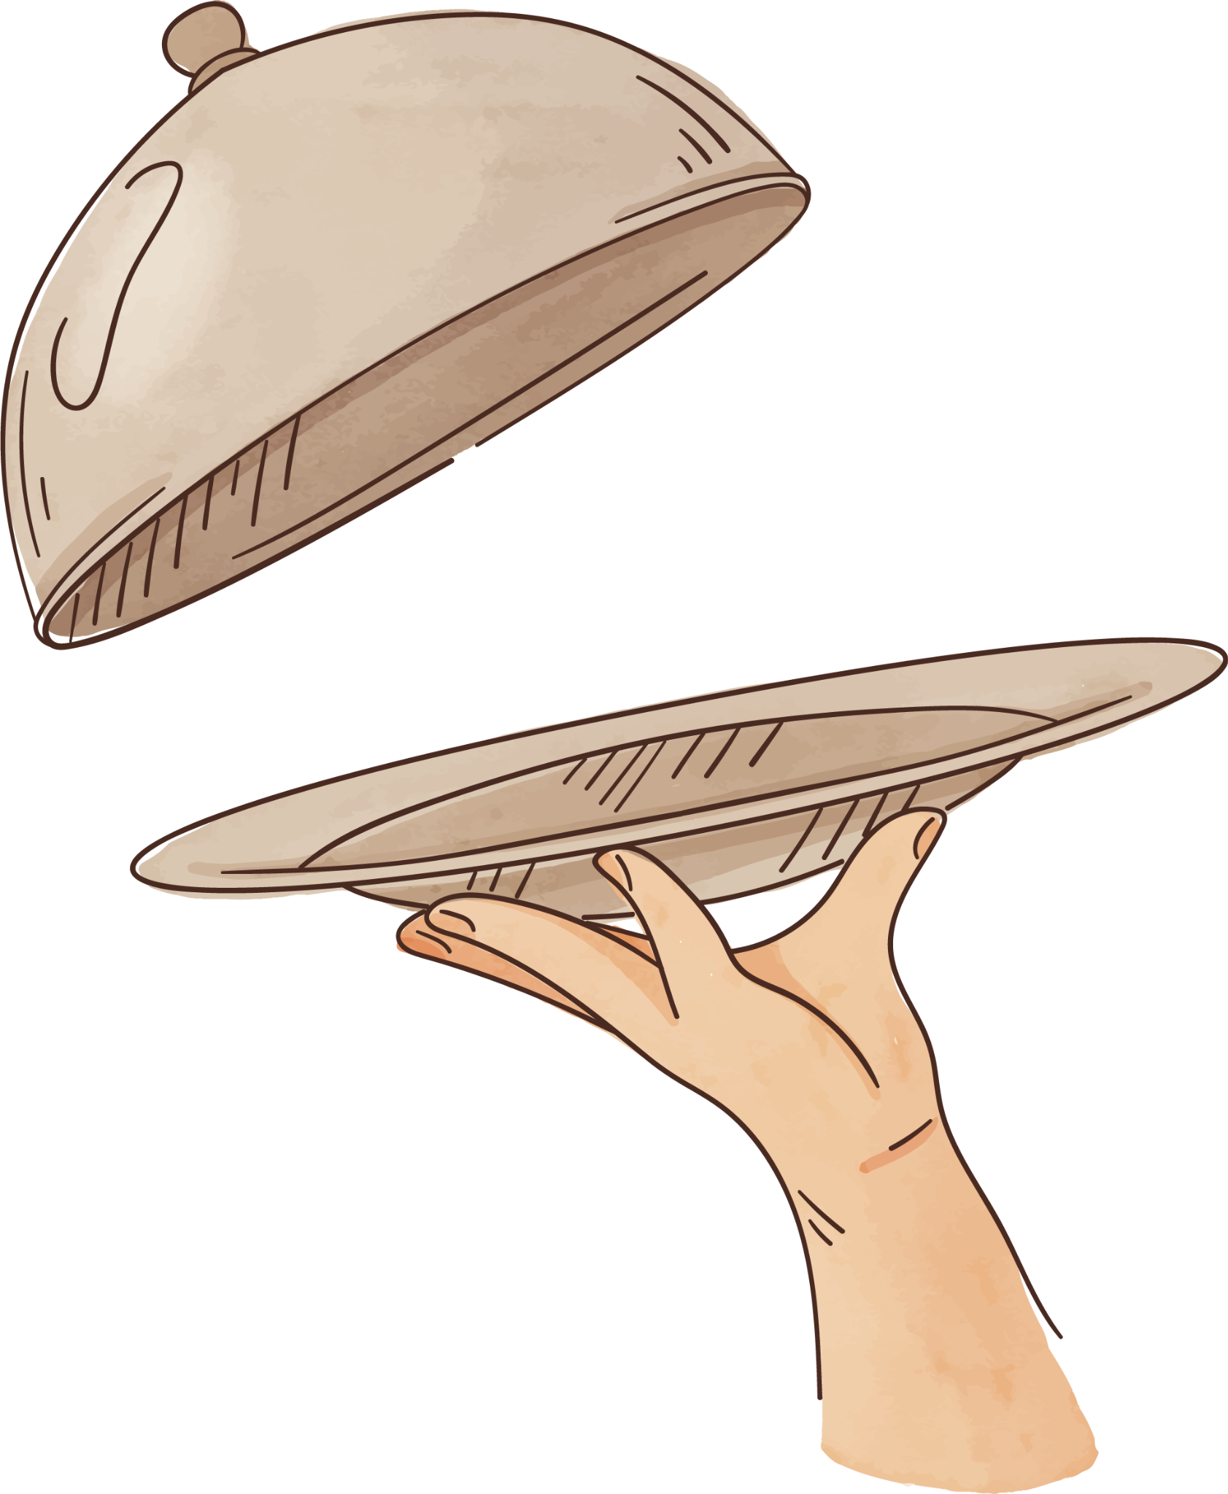



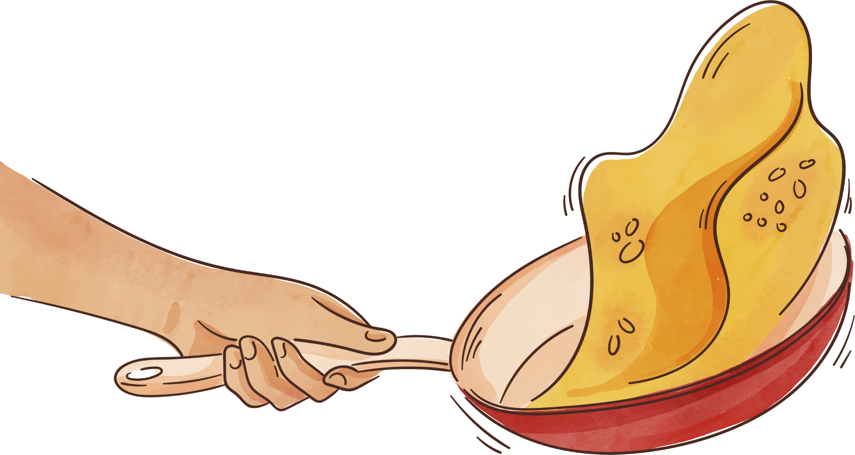

Bon Appétit!
Thanks

